Slide 1
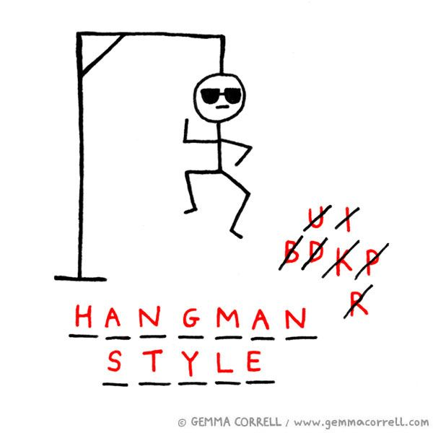
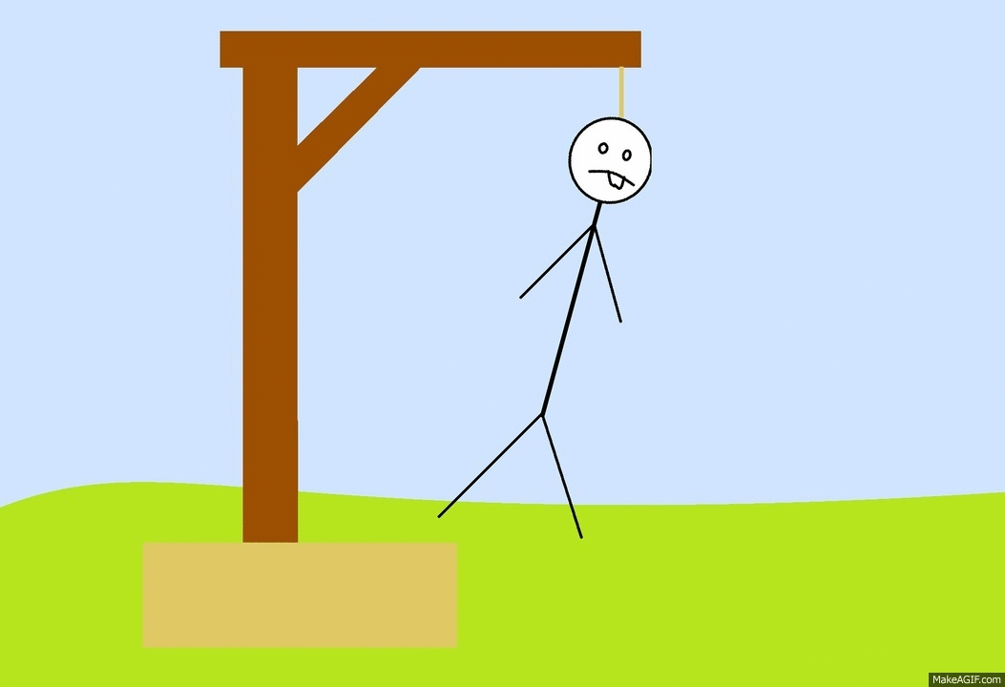
Hangman!!!
By: Tyler Doherty

Slide 2
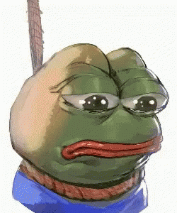
Overview
This is the classic game hangman
Enter letters to guess what the word is
Randomly selects one of the word choices

Slide 3
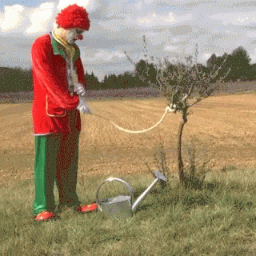
Introduction
Have you ever been really bored and wanted a new game to play? This creation solves the problem of boredom by giving you hours of fun! This projects main features are randomly selecting one of the 5 words, Tells you when you make a correct or incorrect guess, Welcomes you to the game, only allows you 6 attempts, And tells you the correct word if you run out of guesses!

Slide 4
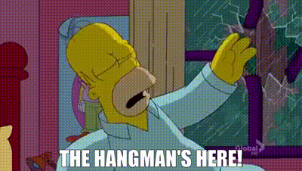
Technical Details
Tech, Programming Languages, and Tools used?
- A computer, Python, And our Class Notebooks ☺
Algorithms, Data Structures, or Design Patterns employed?
- Random Word Selections, Displaying the Guessed Word, Handling User Input, Preventing Duplicate Guesses, and Winning or Losing Conditions!

Slide 5
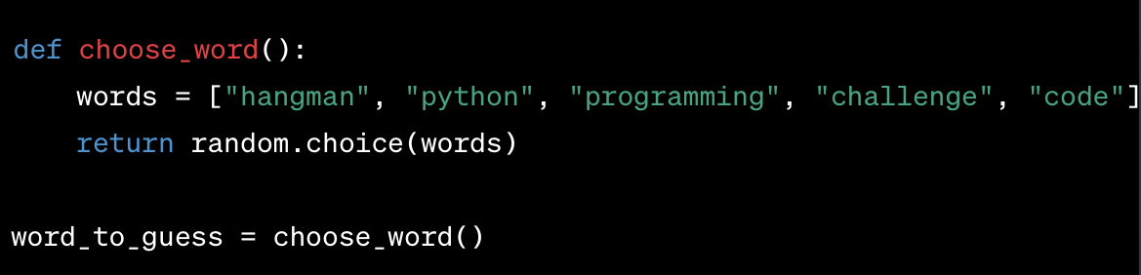
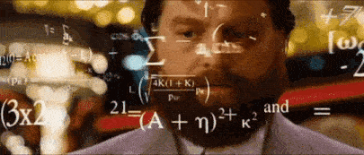
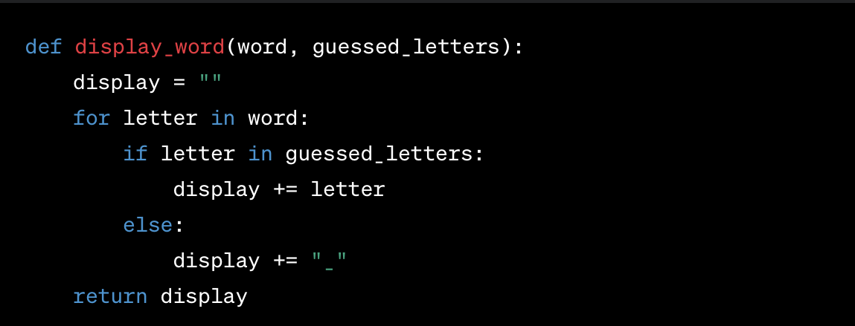
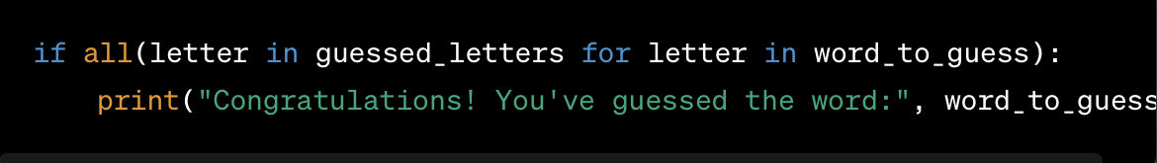
Implementation
Word Selection and Initialization
Displaying the Guessed Word
Winning or Losing Conditions:

Slide 6

Challenges and Solutions
Wordy Code
- Reading what I had down and simplifying it
Random Word Selection
- Research online of how to create it
Setting amount of attempts
-Also researched online to learn how to do it

Slide 7
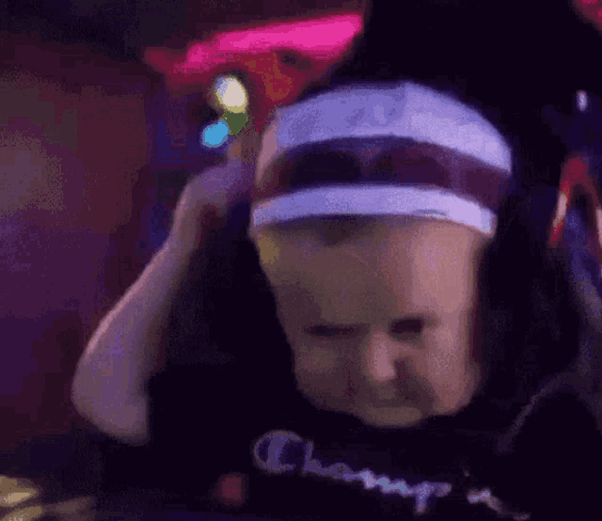
How to Interact With App
Open Python File!
Start Code!
Enter A letter to guess!
Keep guessing until failure or victory!
Play again!

Slide 8
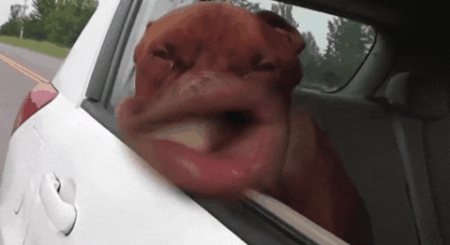
Demonstration
OPEN FILE!!!!!

Slide 9
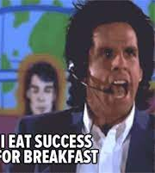
Lessons Learned
How to make Hangman on Python
How to make random word selection
How to make certain number of guesses allowed
Don’t over complicate it

Slide 10
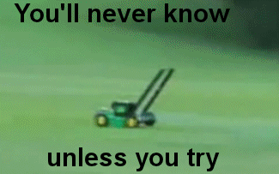
Summary and What Could Have Been Better
Keep Code Simple
Anything is possible if you know how to do it
Lots of recourses to learn how to do stuff you don’t know
Could have had better user interface
Could have put more than 5 words to guess
Could have made the design prettier

Slide 11
Sources
https://www.w3schools.com/python/ref_random_choice.asp
https://stackoverflow.com/questions/70948469/how-to-write-a-script-that-only-allows-a-limited-number-of-attempts-to-input-som
And Our Class Notebooks

Slide 12
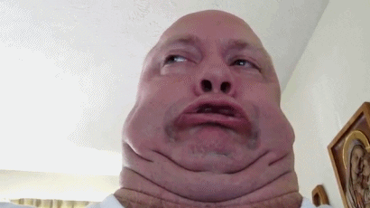
Thanks!

